Slide 1
Food Ordering Chatbot with FastAPI Backend
Improving Chatbot Responsiveness
SDP ID:20240116
Sasi Preetham B
20BCE7362
Teja Naga Sai G 20BCE7361

Slide 2
Literature Survey
Studies on Chatbot Responsiveness:
Research indicates that chatbot responsiveness plays a crucial role in user satisfaction and engagement.
Studies have shown that users prefer chatbots that can understand and respond to their queries promptly and accurately.
DialogFlow and Chatbot Development:
Documentation and research papers highlight the benefits of using Google DialogFlow for developing conversational agents.
DialogFlow' s natural language understanding capabilities and integration with various platforms make it a popular choice among developers.
FastAPI and API Development:
Articles and tutorials showcase FastAPI as a modern and efficient framework for building APIs with Python.
FastAPI's asynchronous features, automatic documentation generation, and type hinting support are highlighted as key advantages for developers.

Slide 3




Aim
To develop a food ordering chatbot using Google Dialogflow and a backend Python FastAPI connected to a SQL database
By leveraging the strengths of both technologies, we anticipate achieving a seamless interaction between users and the chatbot while ensuring reliability, scalability, and ease of maintenance

Slide 4
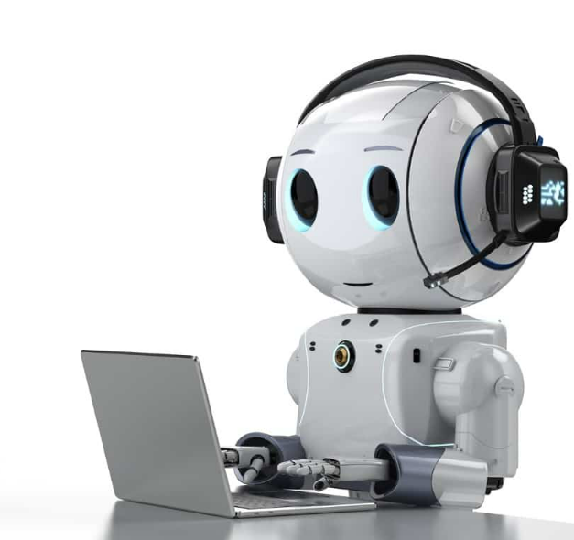
Objective
The primary objective is to enhance chatbot responsiveness through the implementation of FastAPI.
The secondary objective is to reduce misclassification errors.
The third objective is to reduce the learning curve to operate the chatbot.

Slide 5


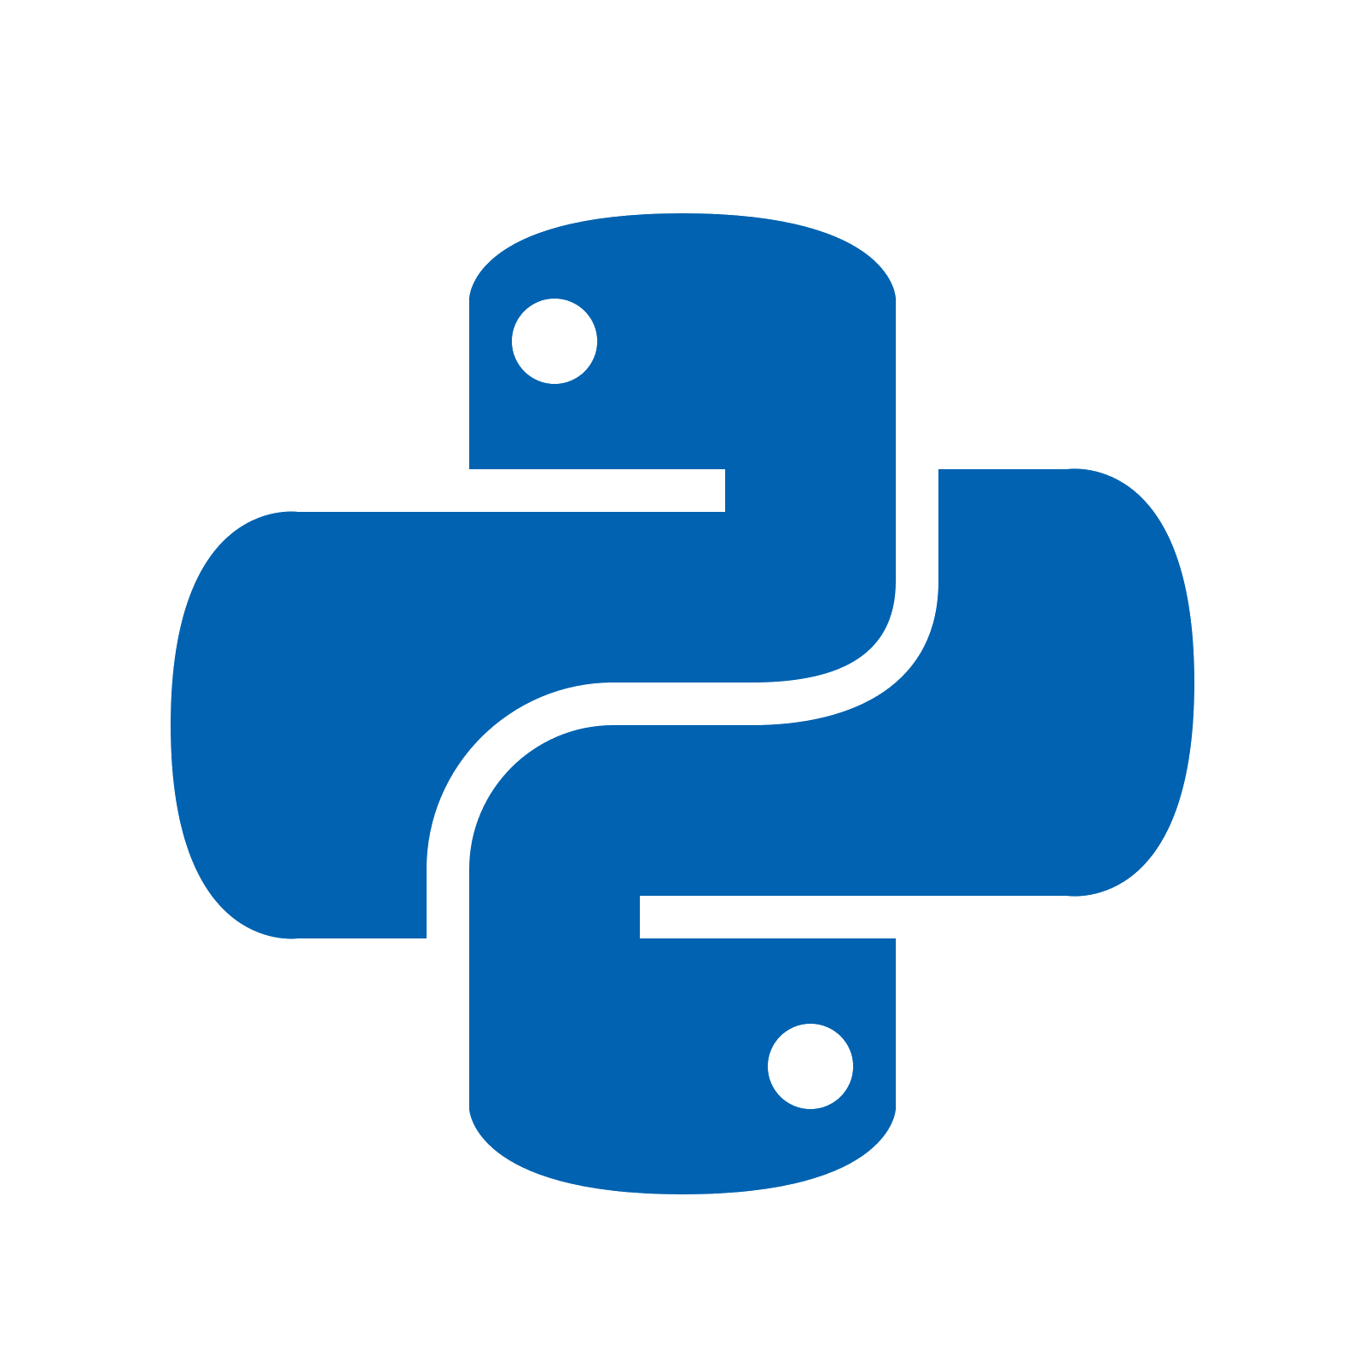
Tools and Technologies:
MySQL Database: Use MySQL to store and manage order details, menu items, and customer information
Web Development: Basic web development skills (HTML, CSS, JavaScript) might be required to embed the chatbot on your website and handle frontend interactions.
Server-side Scripting: Python is used to create server-side scripts for integration with MySQL database and handling order-related operations.

Slide 6
Tools and Technologies:
FastAPI:
FastAPI is known for its high performance
Asynchronous request handling
FastAPI is designed to be easy to use and intuitive
Dialogflow:
Dialogflow provides powerful NLP capabilities, allowing developers to build chatbots that can understand and interpret natural language input from users.
Dialogflow supports integration with multiple messaging platforms, including Google Assistant, Facebook Messenger, Slack, and more.
Dialogflow maintains context across conversational turns, allowing chatbots to remember previous interactions and provide more contextually relevant responses.

Slide 7
STEPS
Designing the conversation flow in Dialogflow
Developing the FastAPI backend for handling requests
Integrating Dialogflow with FastAPI
Setting up and managing the SQL database
Testing and iterating the chatbot functionality
Frontend

Slide 8
COMPLETION STATUS
Designing the conversation flow in Dialogflow
Developing the FastAPI backend for handling requests
Integrating Dialogflow with FastAPI
Setting up and managing the SQL database
Frontend
Testing and iterating the chatbot functionality

Slide 9
NEXT STEPS
Frontend, Split the menu up into breakfast, lunch, dinner..
Testing and iterating the chatbot functionality

Slide 10
CONCLUSION
The combination of Google DialogFlow and FastAPI offers a powerful solution for developing responsive and efficient chatbots.
By leveraging DialogFlow's natural language understanding and FastAPI's high performance and ease of development, we aim to create a seamless food ordering experience.
Our project demonstrates the effectiveness of integrating cutting-edge technologies to enhance user interaction and streamline processes.
Moving forward, we anticipate further refinements and enhancements based on user feedback and ongoing development efforts.

Slide 11
THANK YOU

